Slide 1
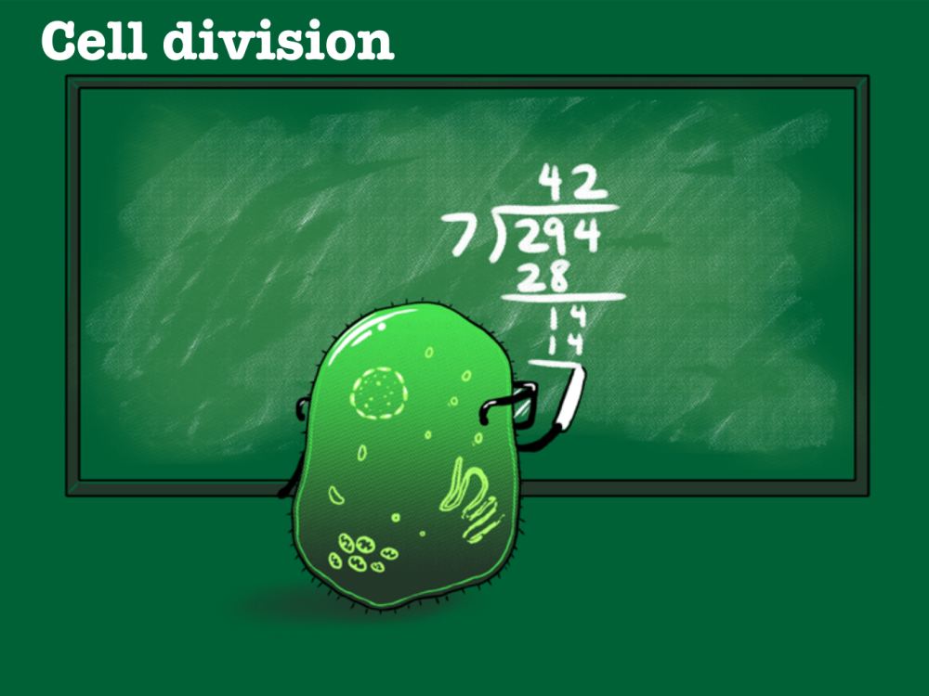
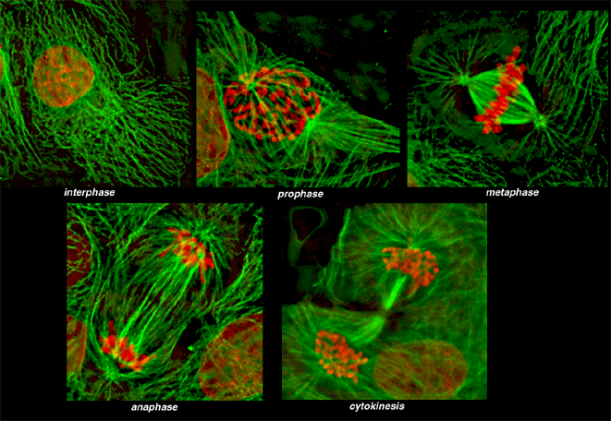
Mitosis
Chapter 14 New Body Cells page 180-190
Cell Cycle
Mitosis

Slide 2
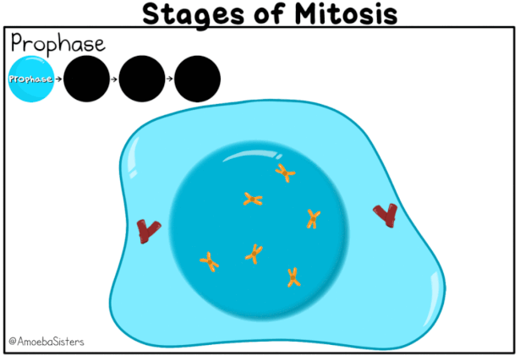

Slide 3
Learning Intentions
By the end of today’s lesson you should be able to:
Name and describe the cell cycle phases by drawing a diagram
Explain that mitosis is the division of body cells for growth, repair and replacement by using specific examples
Name and describe the stages of mitosis by drawing a series of labelled diagrams

Slide 4
The greater the wear and tear, the shorter the lifespan
Where in the body would be subjected to wear and tear and therefore need to be replaced often?

Slide 5
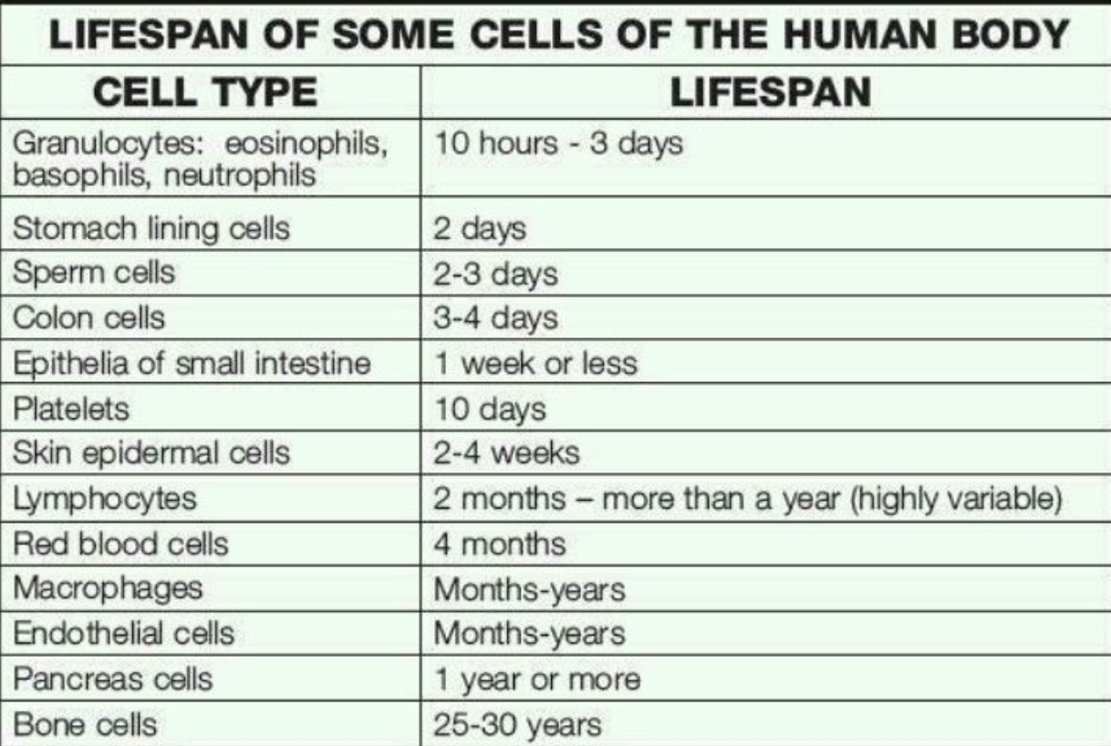

Slide 6
Notes:
What is happening? Tell person next to you

Slide 7
Cell Division
Mitosis (M phase) is the process of making new cells
This is for growth (new cells) and repair (replace old cells)
Mitosis occurs in all somatic cells
The new cells created, called the daughter cells, have the exact same number of chromosomes as the parent cell
This means they are genetically identical

Slide 8
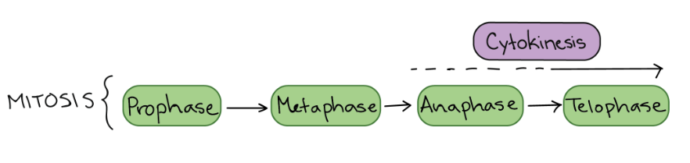

Slide 9
Mitosis
Interphase (a mitosis pretender)
Prophase
Metaphase
Anaphase
Telophase
Cytokinesis (a mitosis follower)

Slide 10
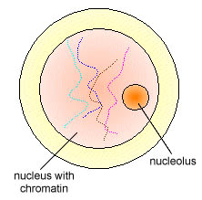
Interphase – Parent cell

Slide 11
Interphase
During G₁ S and G₂
S: DNA duplicates still in chromatin form

Slide 12
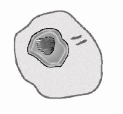

Slide 13
Prophase

Slide 14
Prophase
Chromatin condenses and become visible chromosomes (each made of 2 sister chromatids)
Nucleolus disappears
Pairs of centrioles move to opposite poles of cell & microtubules form
Nuclear membrane breaks down
Microtubules form spindle
Spindle fibres attach to the centromere
Notes:
The spindle is a structure made of microtubules. Its job is to organize the chromosomes and move them around during mitosis. In prophase, the spindle grows between the centrosomes as they move apart.
Chromosomes formed from 2 chromatids with centromere
In late prophase (sometimes also called prometaphase), the mitotic spindle begins to capture and organize the chromosomes.

Slide 15
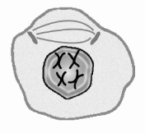
Prophase

Slide 16
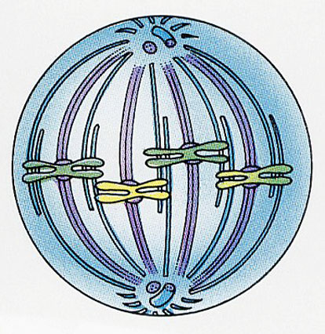
Metaphase

Slide 17
Metaphase
Chromosomes line up on metaphase plate/equator
Notes:
Metaphase plate (not a physical structure, just a term for the plane where the chromosomes line up).
Before proceeding to anaphase, the cell will check to make sure that all the chromosomes are at the metaphase plate with their kinetochores correctly attached to microtubules. This is called the spindle checkpoint and helps ensure that the sister chromatids will split evenly between the two daughter cells when they separate in the next step.

Slide 18
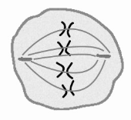

Slide 19
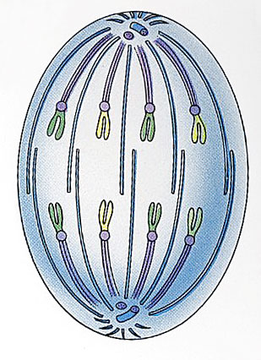
Anaphase

Slide 20
Anaphase
Spindle fibres contract towards the centrioles
The chromosome are separated at the centromere
Sister chromatids are pulled to opposite poles of the cell (they are now individual chromosomes)
Notes:
Microtubules not attached to chromosomes elongate and push apart, separating the poles and making the cell longer.

Slide 21
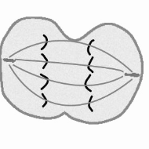

Slide 22
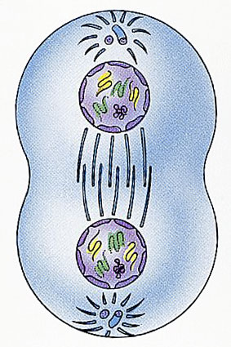
Telophase

Slide 23
Telophase
Chromosomes arrive at poles of cell
Chromosomes return to uncondensed chromatin form
Spindle fibres disappears
The nuclear membrane and nucleus reforms at each pole
Cytokinesis begins
Notes:
The mitotic spindle is broken down into its building blocks.
Two new nuclei form, one for each set of chromosomes. Nuclear membranes and nucleoli reappear.
The chromosomes begin to decondense and return to their “stringy” form.

Slide 24
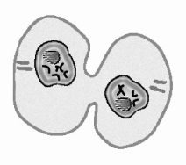

Slide 25
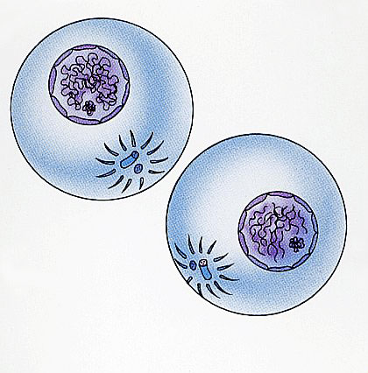
Cytokinesis

Slide 26
Cytokinesis
During telophase
Division of cytoplasm
Furrow develops (cleavage furrow)
2 daughter cells
Identical
Notes:
the division of the cytoplasm to form two new cells, overlaps with the final stages of mitosis. It may start in either anaphase or telophase, depending on the cell, and finishes shortly after telophase.
In animal cells, cytokinesis is contractile, pinching the cell in two like a coin purse with a drawstring. The “drawstring” is actually a band of filaments made of a protein called actin, and the pinch crease is known as the cleavage furrow.

Slide 27
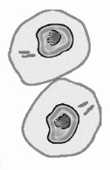

Slide 28
Stage | Events
Interphase
Prophase
Metaphase
Anaphase
Telophase
Cytokinesis

Slide 29
Notes:
Metaphase

Slide 30

Notes:
Prophase (early on)

Slide 31
Notes:
Telophase (cytokinesis)

Slide 32
Notes:
Anaphase

Slide 33
